Slide 1
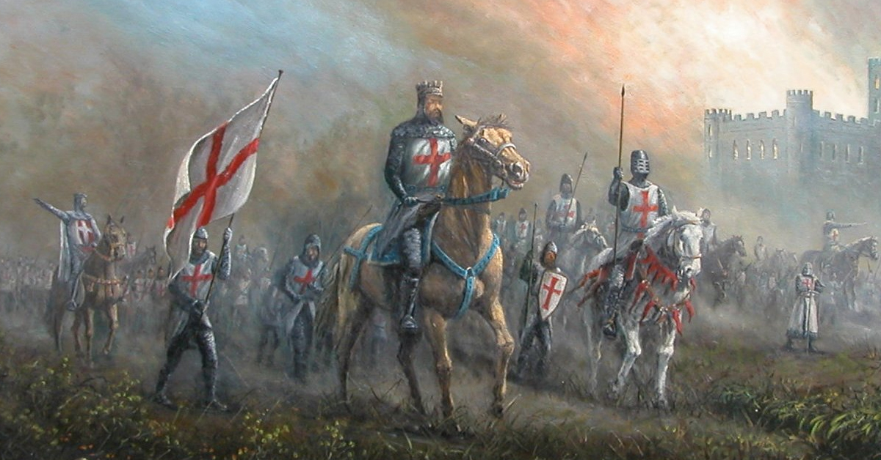
Indiana Templar Academy
Uniforms

Slide 2
There are 4 types of Uniforms authorized in Indiana

Slide 3
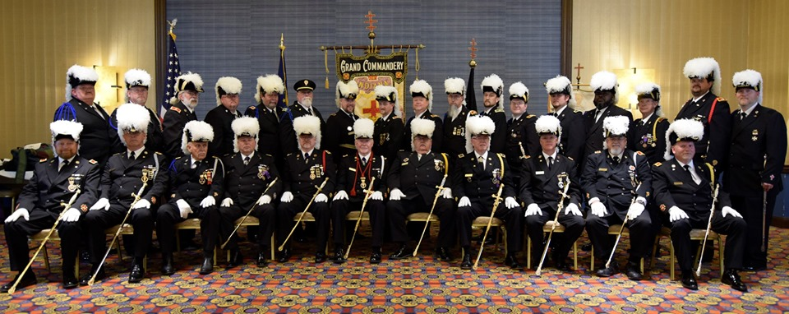
The Standard Uniform
Grand Commandery 2019

Slide 4
Jewels And Bars
Only Templar jewels are to be worn on the Templar Uniforms. Reasonable enough isn’t it - Templar Uniform and Templar Jewels. But you still see Past Master Jewels, Past High Priest Jewels, Past Illustrious Master Jewels, Knight Masons Jewels, and Knight York Cross of Honor Jewels worn on or with the Templar uniform. These jewels just mentioned are not Templar Jewels and should NEVER be worn on the Templar uniform.

Slide 5
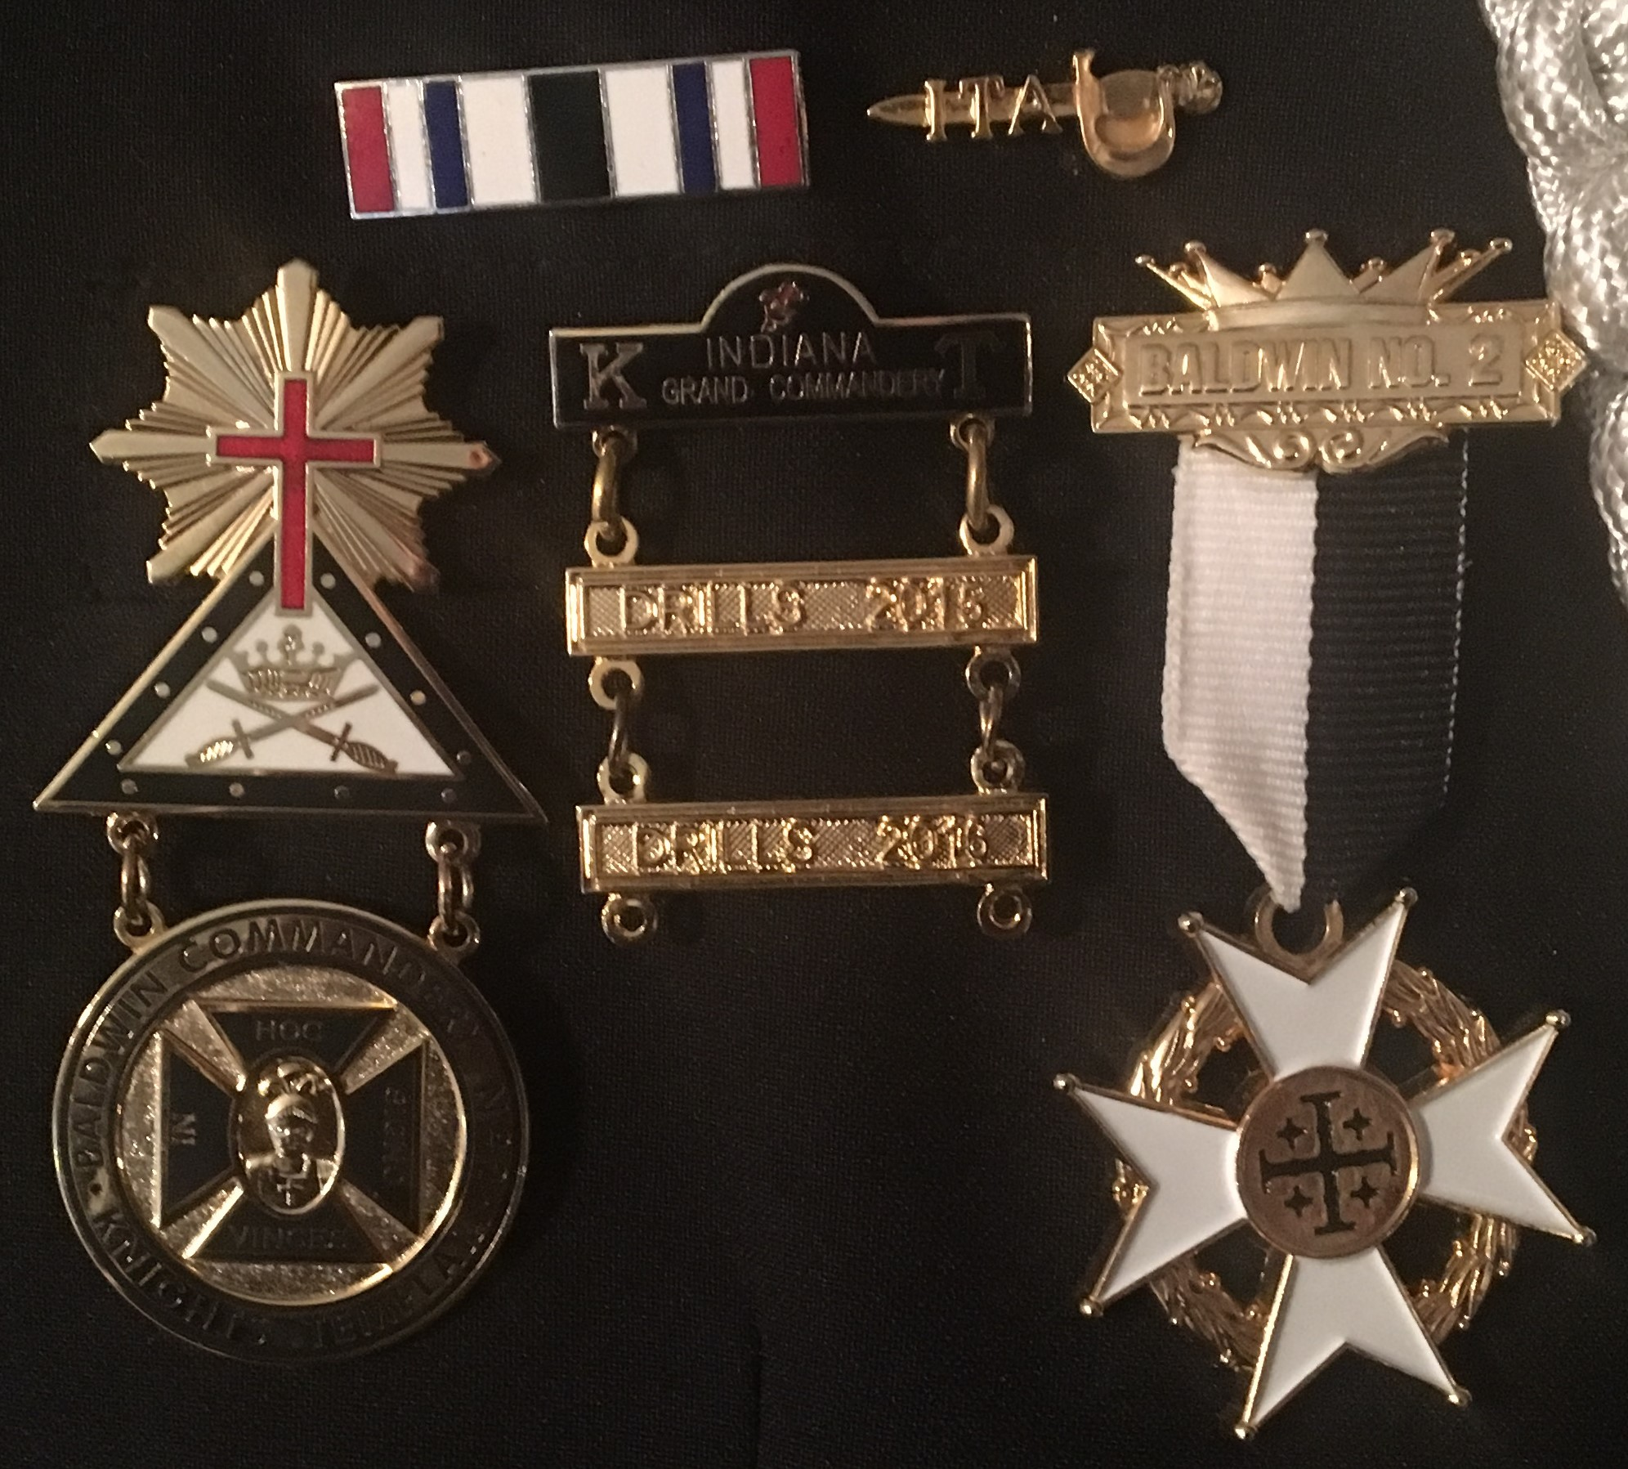
The top of the jewel or jewels worn should be even with the top edge of the pocket welt.

Slide 6
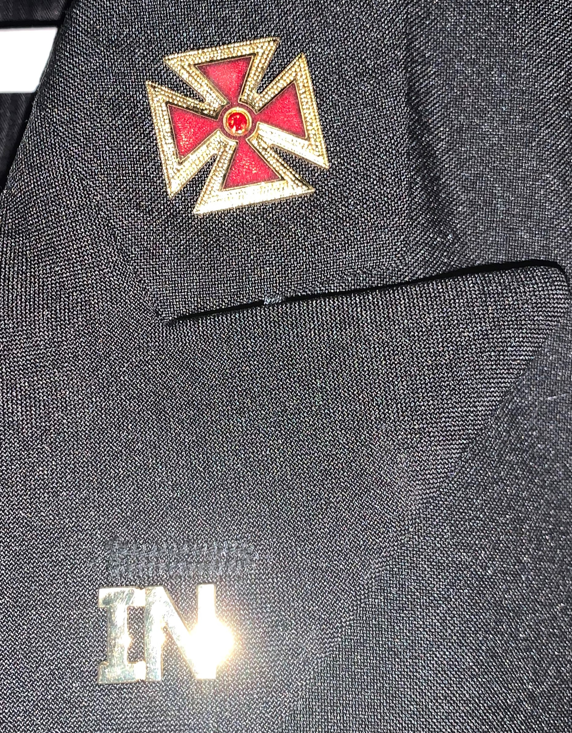
Rank of Office
On point of collar ½” above lapel seam and ½” from outside edge of collar, shall be a 1” cross of appropriate rank-
Grand officer- gold templar cross
Past or current Commander- gold passion cross
Sir Knight- silver passion cross
½ Inch
1 ½ in
Optional:
State of Indiana abbreviations and Commandery numeric lapel device may be worn on respective lapels.
1 ½” below the notch of the collar seam and ½” in from the outside edge of the lapel.
Grand Commandery Officers: wears gold ½” “IN” on both lapels.
½ in

Slide 7
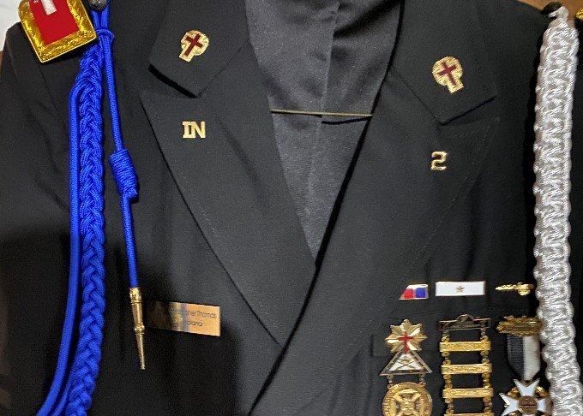
Optional:
Past and current Commanders: gold ½”“IN” on right lapel gold ½” numeral on left lapel.
Sir Knights: silver ½”“IN” on right lapel silver ½” numeral on left lapel.
Blue Deputy Battalion Commander cords and Aide cords will be worn on the right shoulder.
Membership cords will be worn on left shoulder.
Both held in place with a black Knight Templar button.
Optional:
Name tag- shall be worn on the right breast, centered and horizontal with the left breast welt.

Slide 8
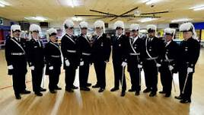
The Long(Frock)Coat Uniform
Raper Commandery
Drill Team

Slide 9
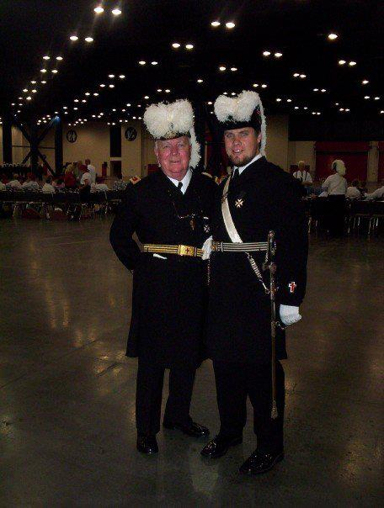
The Long(Frock)Coat Uniform
Collar brass and shoulder board are worn the same as with the Standard uniform.
The Jewels and bars are in line and centered with the top button of the Frock coat on the wearers left breast.
Sir Knights wear a silver sling belt with a baldric across there right shoulder.
Past Commanders were a gold sling belt with no baldric

Slide 10
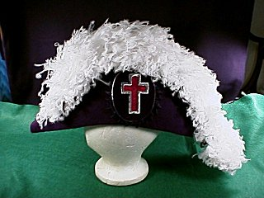
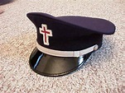
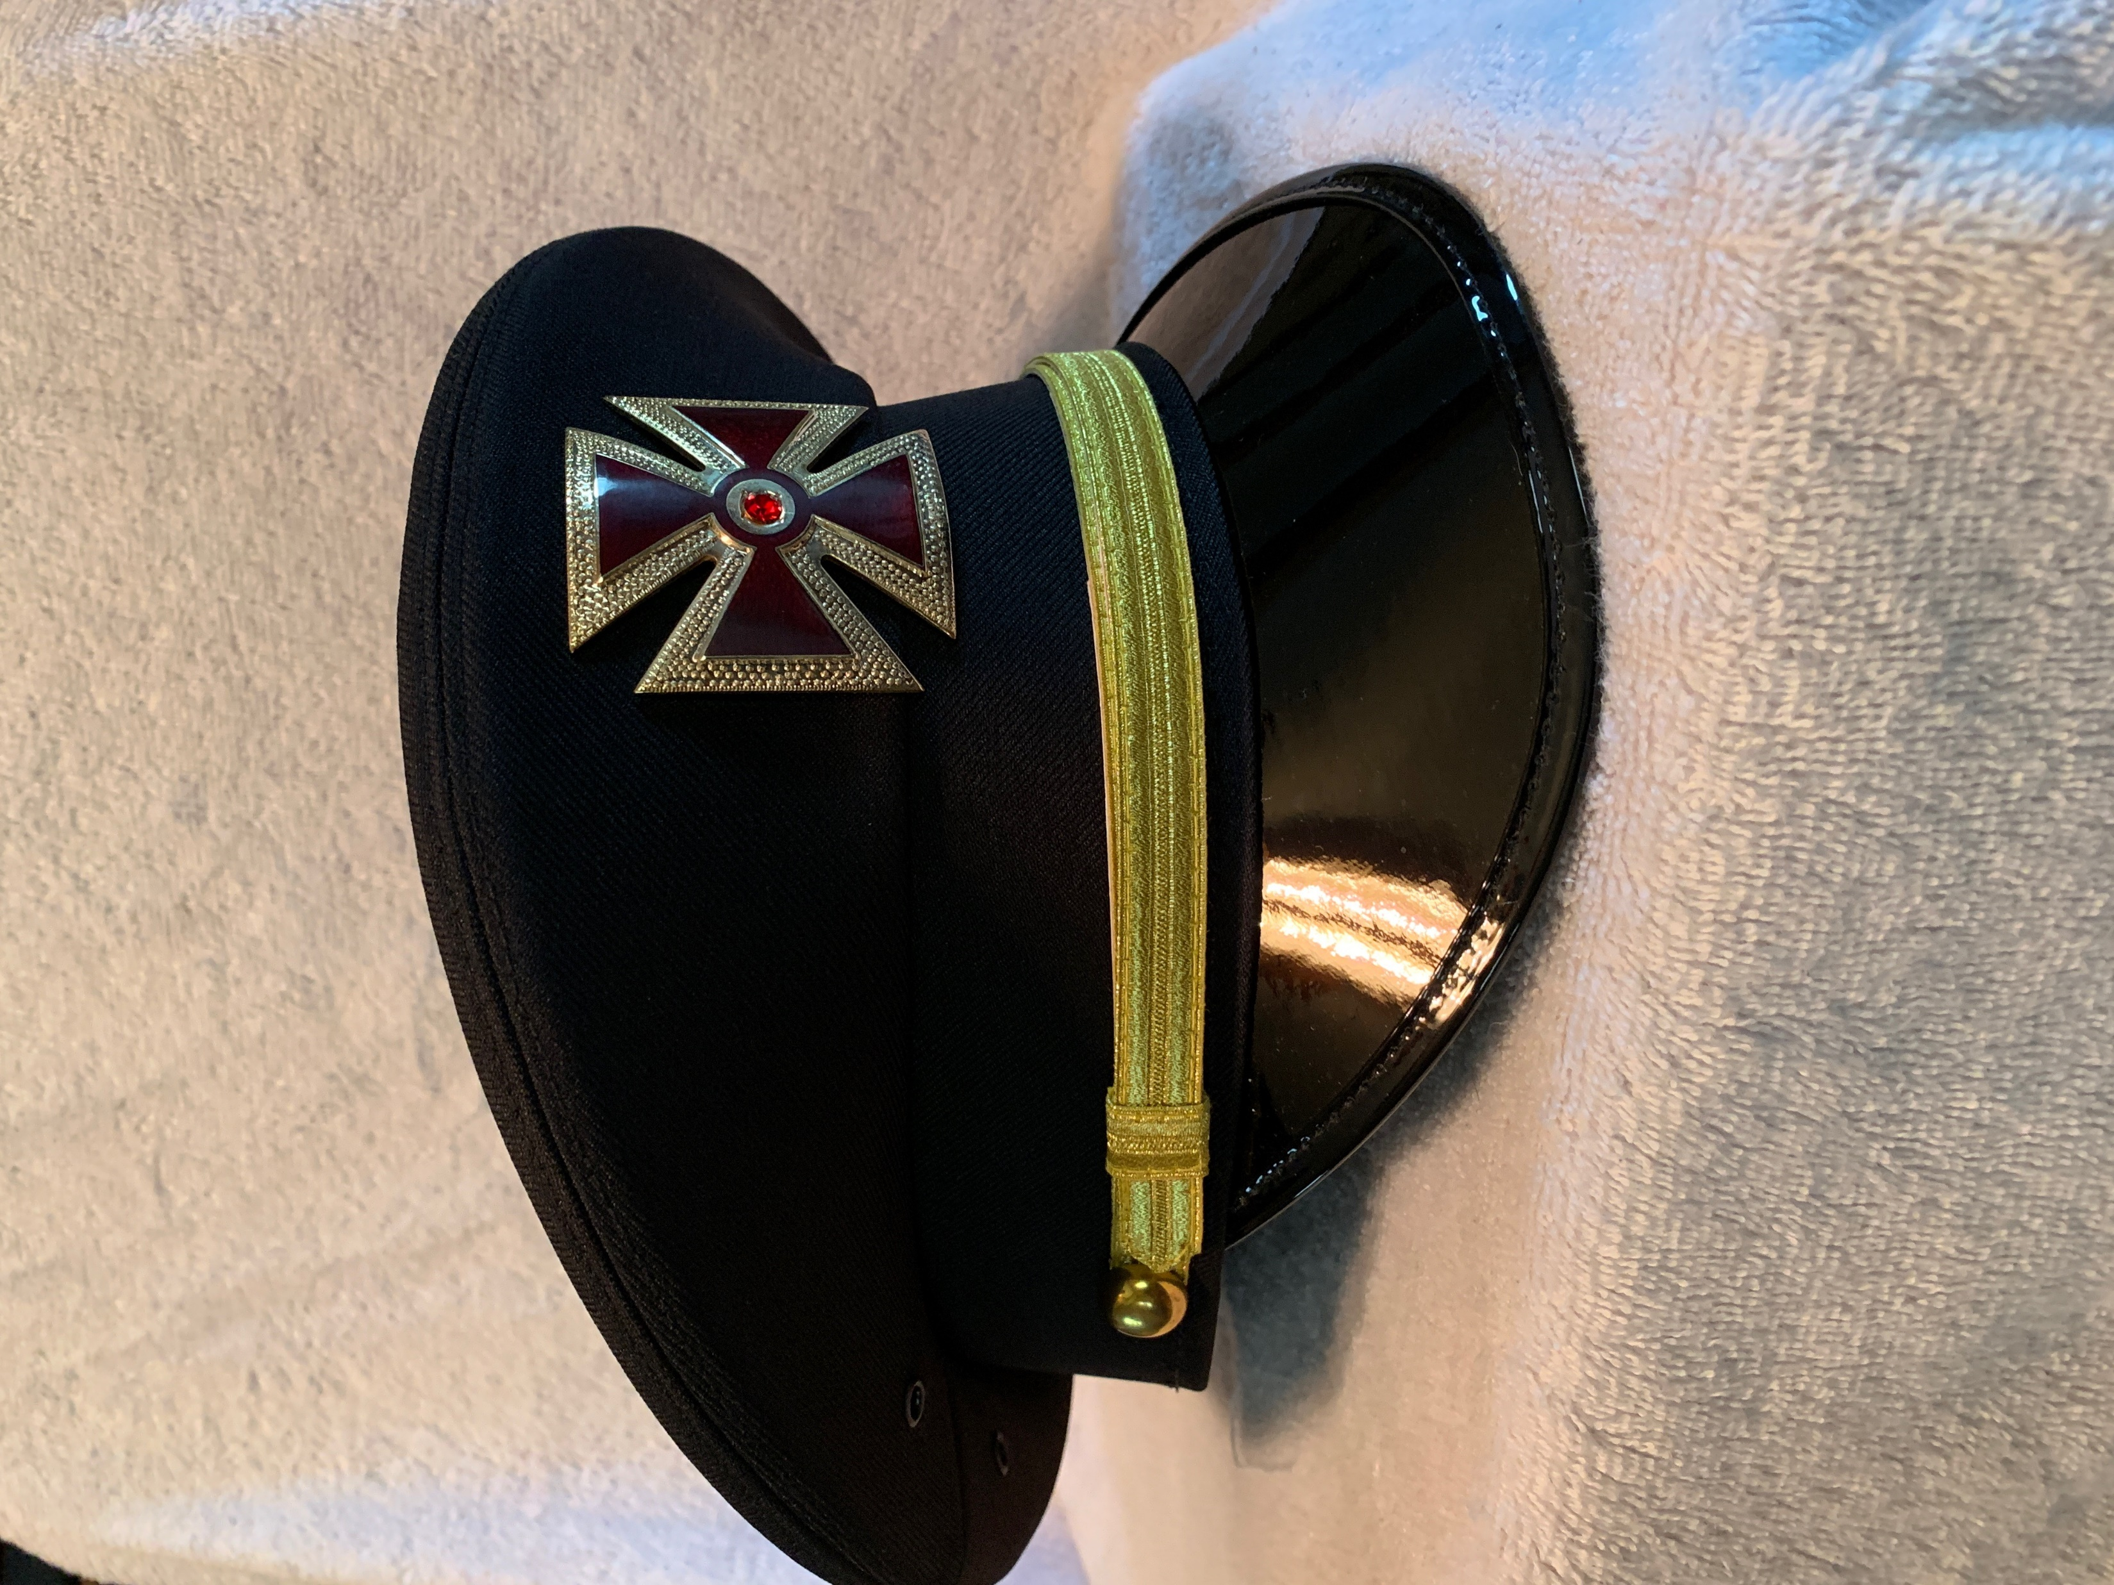
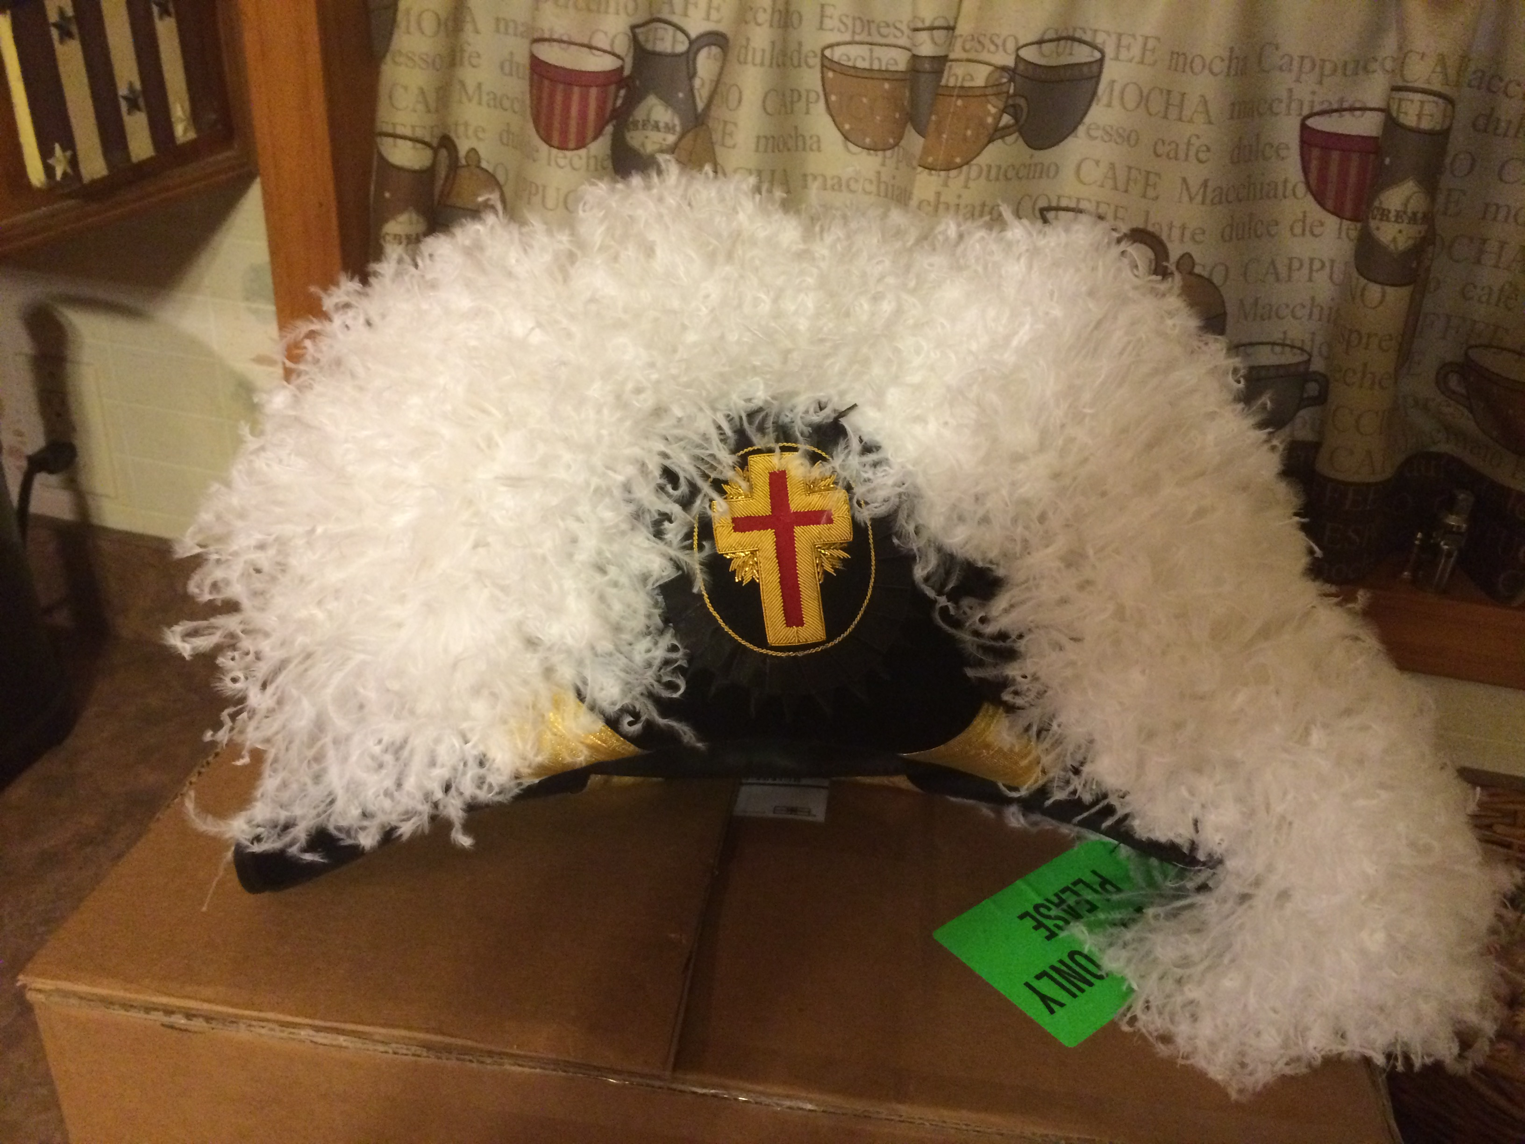
Authorized Headgear for Indiana Sir Knights
Sir Knight
Sir Knight
Standard and Long Coat Uniforms
Past Commander
Grand Commandery Officer

Slide 11
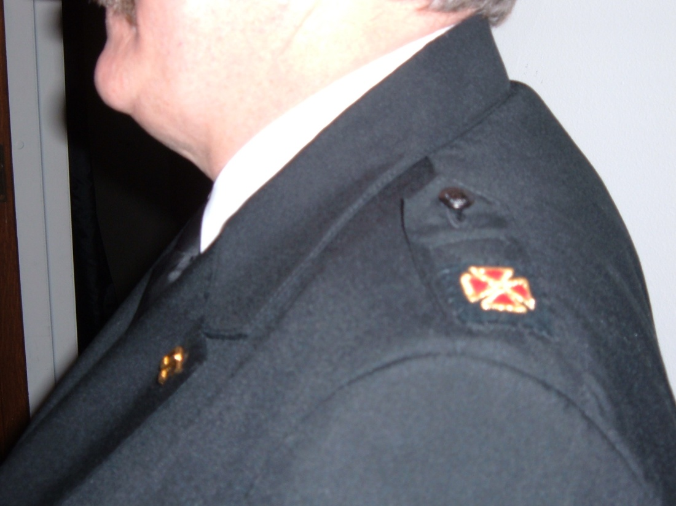
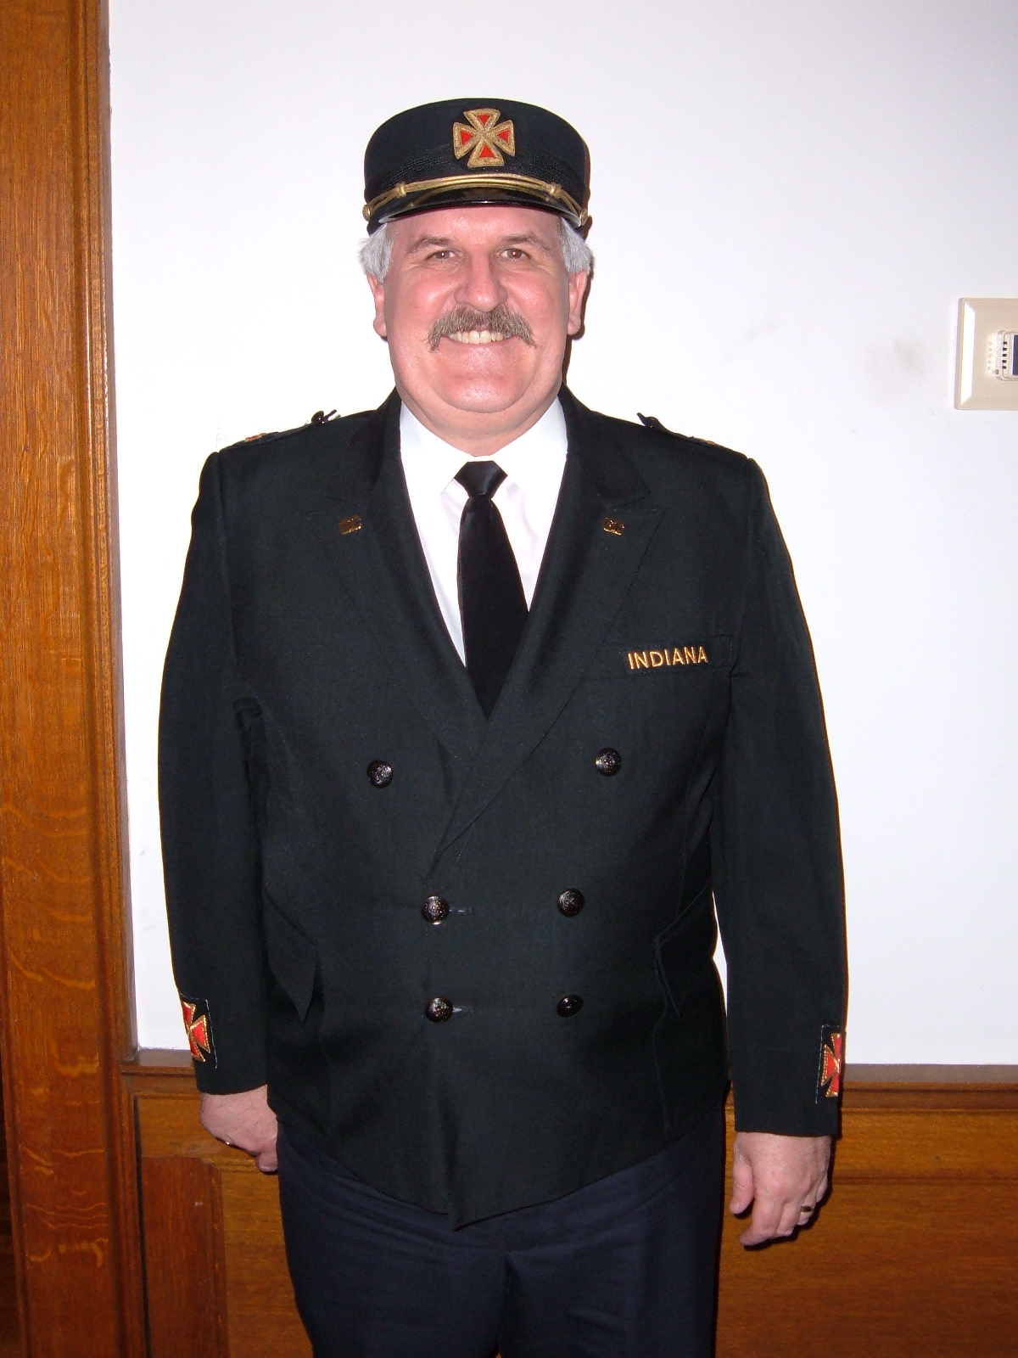
The Fatigue Uniform
All patches are sown on uniform jacket

Slide 12
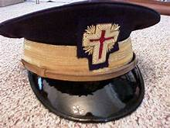
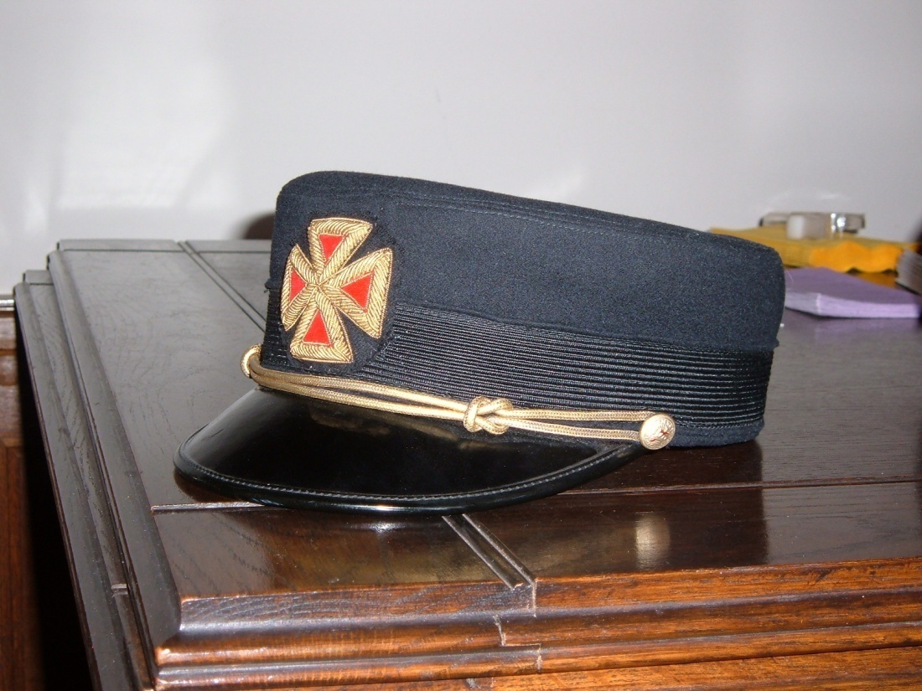
Authorized Headgear
for the Fatigue Uniform
Pershing Cap with gold band and gold chin strap for Past Commanders and Grand Officers and a Silver band and silver chin strap for Sir Knights.
Bell Crown Cap with gold band

Slide 13
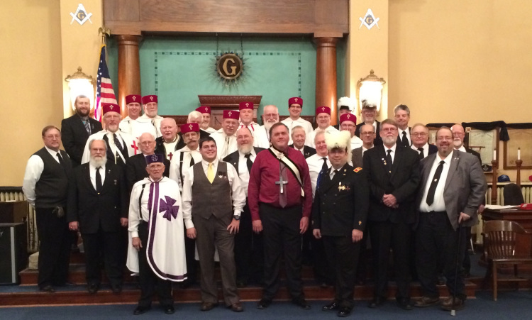
The Cap and Mantle
Vincennes Commandery

Slide 14
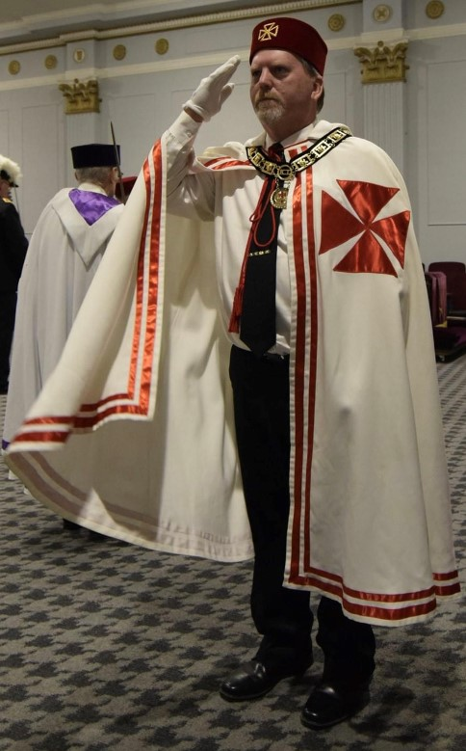
Cap and Mantle
Solid black tie (no markings on tie)
Long sleeve white shirt
Black pants
Grand Commandery Collar goes on outside of Mantle
White or buff gloves
No jewels are to be worn on Mantle
Office Jewel is worn around the neck on a chain

Slide 15
Commandery Swords

Slide 16
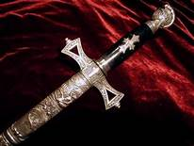
Sir Knight Sword
Silver crown and sheath
Black handle
No Chain

Slide 17
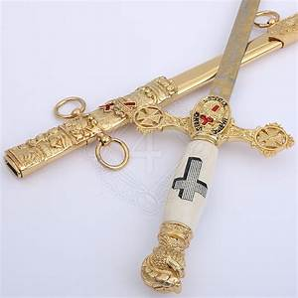
Past Commander
Sword
Gold crown and sheath
White handle
No Chain

Slide 18
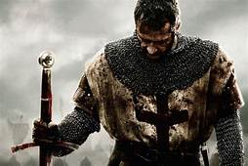
Question?

